Slide 1
Connecting Academics & Parents
Academic seminars to sharpen skills and build understanding in
Addition and Subtraction:
Beyond the Basic Facts
Notes:
Step by step directions:
Introduce yourself.
Share with parents that these workshops, CAP (Connecting Academics and Parents), were created based on feedback from parents wanting to learn more about the math concepts and how to help their children at home.
Materials for training:
Hundreds charts
Base ten blocks
Decks of cards
Technology
Powerpoint packets

Slide 2
Math may look different now.
There’s nothing better than seeing your kids SUCCEED
and there’s nothing worse than not being able to help them when they are struggling.
Research from
Dr. Drew Westen, Emory professor,
and 100Kin10
Notes:
Share with parents that math may look different now. There’s nothing better than seeing your kids SUCCEED and there’s nothing worse than not being able to help them when they are struggling. This is research from Dr. Drew Westen, who is a professor at Emory University. Dr. Westen’s work was developed in collaboration with 100Kin 10.

Slide 3
Times change,
technologies change,
and knowledge changes
about how to teach kids to apply what they know to real-life situations.
for joining in to learn more about how to help with math.
Thank you
Research from
Dr. Drew Westen, Emory professor,
and 100Kin10
Notes:
Share that times change, technologies change, and knowledge changes too about how to teach kids to apply what they know to real-life situations. Thank parents for joining in to learn more about how to help with math.

Slide 4
Mathematics Florida Standards Focus
Grade 1
MAFS.1.NBT.3.4
Add within 100, including adding a two-digit number and a one-digit number, and adding a two-digit number and a multiple of 10, using concrete models or drawings and strategies based on place value, properties of operations, and/or the relationship between addition and subtraction; relate the strategy to a written method and explain the reasoning used. Understand that in adding two-digit numbers, one adds tens and tens, ones and ones; and sometimes it is necessary to compose a ten.
Notes:
Step by step directions:
Read standard aloud.
Be sure to clarify that students are only expected to add a two digit number and a one digit number or a two digit number and a multiple of ten NOT a 2 digit number and any 2 digit number.

Slide 5
Mathematics Florida Standards Focus
Grade 1
MAFS.1.NBT.3.6
Subtract multiples of 10 in the range 10-90 from multiples of 10 in the range 10-90 (positive or zero differences), using concrete models or drawings and strategies based on place value, properties of operations, and/or the relationship between addition and subtraction; relate the strategy to a written method and explain the reasoning used
Notes:
Step by step directions:
Read standard aloud.
Be sure to clarify that in first grade students are only expected to subtract multiples of 10 (10-90) from multiples of 10 (10-90).

Slide 6
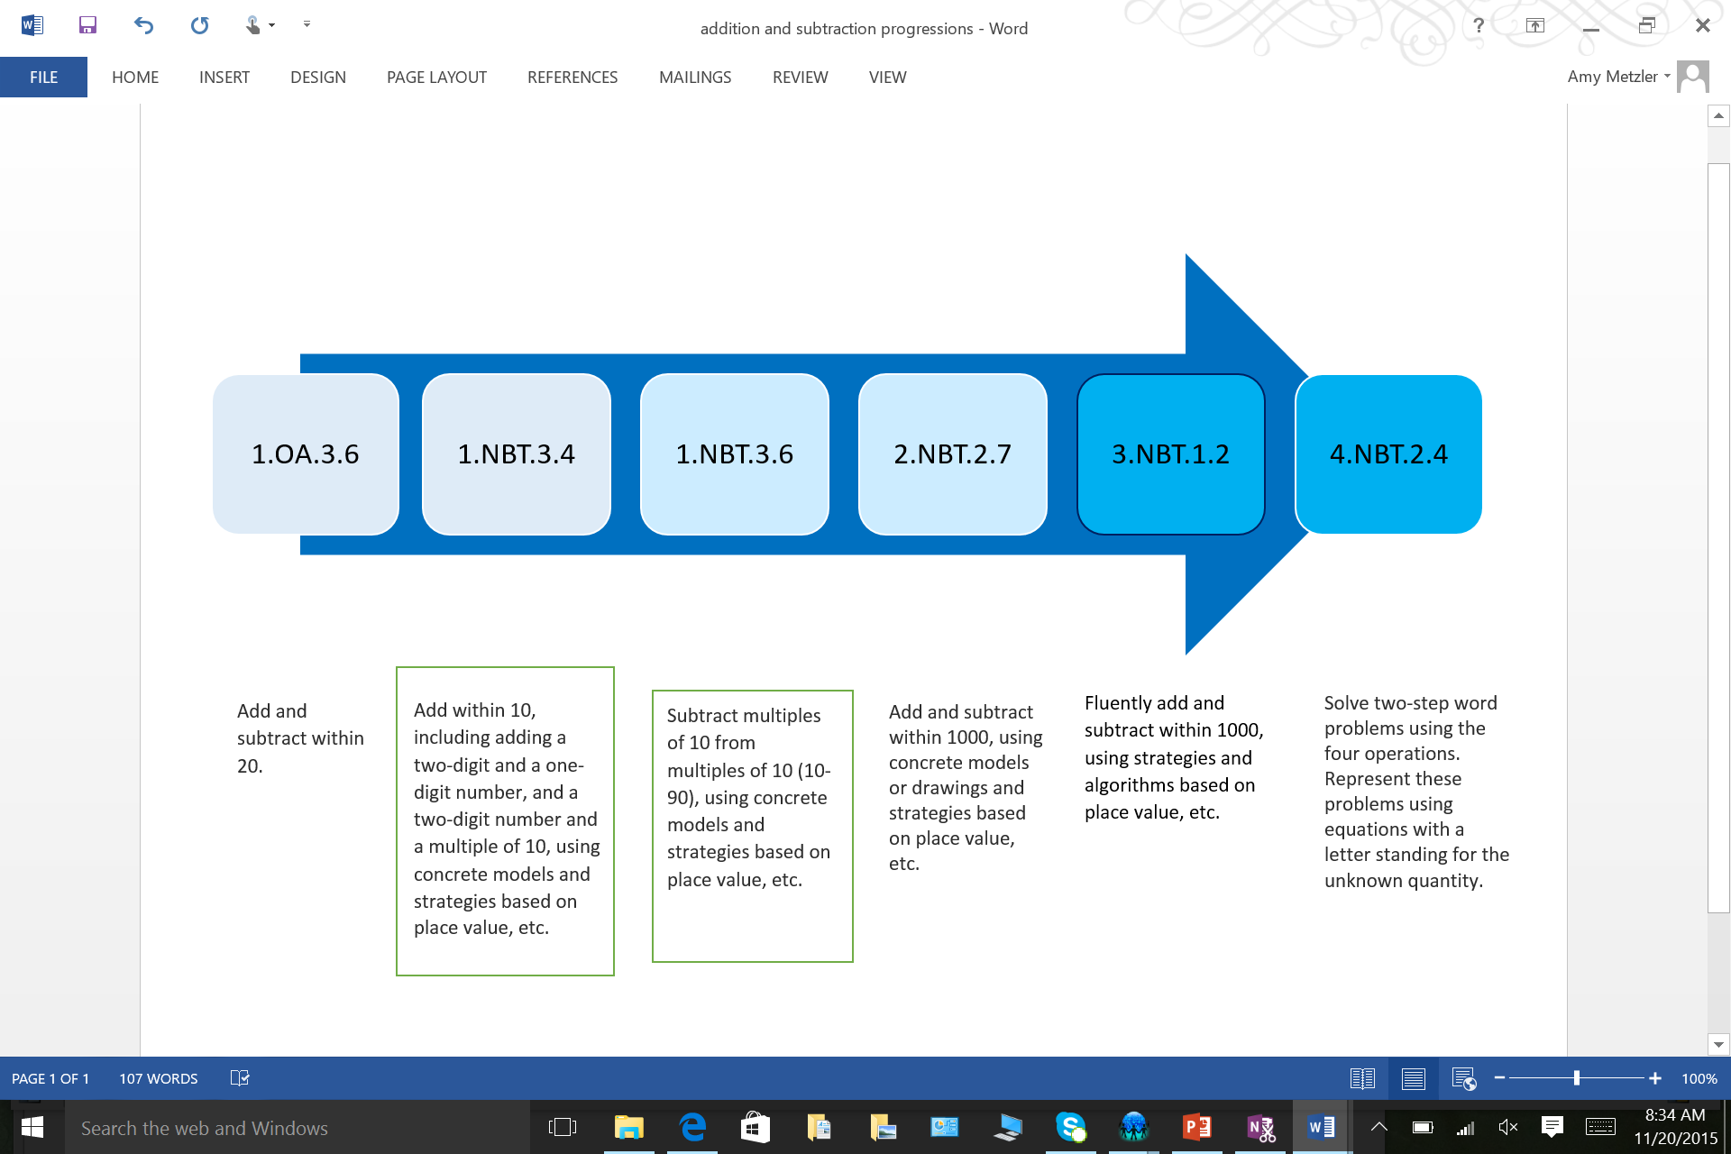
Learning Progression:
2-Digit Addition and Subtraction
Notes:
Step by step directions:
Read each standard summary.
Discuss how addition and subtraction progresses throughout the grade levels.

Slide 7
Adding a two-digit number and a one digit number

Slide 8
There are 56 people waiting in line for the
roller coaster. 8 more people got in line.
How many people are waiting for the roller
coaster now?
How would you solve this problem
without using the standard
algorithm?
Notes:
Step By Step Directions:
Have parents read the problem to themselves and try to solve it without using the standard algorithm. Remind them that the standard algorithm for addition and subtraction does not get taught until second grade.

Slide 9
Hundred Chart
.
Children may start at the greater number and count on by ones.
Notes:
Step By Step Directions:
Give each parent or set of parents a hundred chart.
Share with parents that one of the tools that their children have had a lot of exposure to is the hundred chart. Give parents a minute to look at the hundred chart and share what they notice about how it is organized and why it is beneficial to their children.
Have them discuss how the hundred chart could be used to solve 56 + 8
Click one at a time to model how the hundreds chart could be used to solve 56+8.

Slide 10
Number Line
Children may start at one of the numbers and count on by ones.
56…..57, 58, 59, 60, 61, 62, 63, 64
₊₁
₊₁
₊₁
₊₁
₊₁
₊₁
₊₁
₊₁
56
57
58
59
60
61
62
63
64
Notes:
Step By Step Directions:
Share with parents that students may count by ones to add. They may or may not start with the greater number when adding. The conversation of efficiency can be had with children as they are ready.
Share with parents that children had exposure to the number line since kindergarten. Emphasize that this tool is a way for students to record their thinking in math.
Click one at a time to model for parents how the number line can be used.

Slide 11
Making a Ten
Children may use the strategy of making a ten.
56 + 8 =
56 + 4 = 60
60 + 4 = 64
4
4
+4
+4
56
60
64
Notes:
Step By Step Directions:
Share with parents that making a ten is a basic fact strategy that was introduced in first grade.
Students decompose one number so that a ten can made with the other number.
Click 4 times to show how the 8 is decomposed into a 4 and a 4.
Click to make the number line appear.
Click 7 times to show how the 4 is added to 56 to make 60 and then the other 4 is added to the 60 to make 64
Have parents discuss how this number line differs from the first number line the saw and what their thoughts about it are. Explain to then that number lines are a tool that children can use to explain their thinking and mental math strategies.
Click to show how the above can be represented using number sentences.

Slide 12
Manipulatives
Notes:
Step By Step Directions:
Explain to parents that one tool that students use to model tens and ones are base ten blocks.
A rod equals 10 and a cube equals 1.
Ask the parents what number is modeled on this slide and how they know.
Click 8 times to model how a child would add the 8 ones to the model.
Click to the next slide to show how the child could group the ten ones together.

Slide 13
Manipulatives
Notes:
Step By Step Directions:
Explain to parents that their child has learned that ten ones make a ten.
Click to show how the ten ones could be circled and then traded for a ten to make counting easier.
Remind parents that this is a concrete model based on place value. Their child is not expected to learn the standard algorithm in first grade.
Take a minute to show parents how these base ten blocks can be recorded in a quick pic.

Slide 14
Card Game
Use a deck of playing cards and take out the tens and face cards. The aces will equal 1 in this game.
Your child can flip over two cards and use them to make a two-digit number.
You can flip over one card. This will be the number that will be added to the two-digit number.
Try it ☺
Notes:
Step By Step Directions:
Give parents a few minutes to play this game. Circulate and answer any questions that they may have.

Slide 15
Apply it! ☺
First grade is collecting cans for a food
drive. They have already collected 38
cans. Today, they got 7 more cans.
How many cans do they have now?
Notes:
Step By Step Directions:
Ask the parents to solve the problem using one of the strategies that their child will be using in first grade. Circulate and answer any questions that they may have.

Slide 16
Adding a two-digit number and a multiple of 10

Slide 17
While shopping at the toy store, Julia
bought a video game for $38 and a doll
for $20. How much money did she
spend at the toy store?
Thinking about the strategies that have
already been shared, how do you
think your child would solve
the problem above?
Notes:
Step By Step Directions:
Have parents read the problem to themselves and try to solve it without using the standard algorithm. Remind them that the standard algorithm for addition and subtraction does not get taught until second grade.
Give parents a chance to discuss how they think their child might solve the problem.

Slide 18
Hundred Chart
Notes:
Step By Step Directions:
Share the hundred chart and explain to parents that a child might count on by ones to answer this questions. Ask them if they think this is the most efficient strategy for the child to use. (Anticipated responses: No, it is not efficient to count that great of a number by ones. I can’t believe that you would be wanting my child to do that.)
Ask parents if they can think of a more efficient strategy that a child could use with the hundred chart. (We are looking for parents to say that the children could count by tens.) Click to the next slide to model how a student could count be tens using the hundreds chart.

Slide 19
Hundred Chart
Notes:
Step By Step Directions:
Click 3 times to show parents how their child can use the hundred chart to count be tens.
Explain to parents that children have been taught how to find ten more and ten less than a given number. Explain to parents how they can talk to their child about the pattern when counting by tens. (the tens place is changing and the ones place is staying the same)

Slide 20
Number Line
38 + 10 = 48
48 + 10 = 58
+10
+10
38
48
58
Notes:
Step By Step Directions:
Ask parents to think about how their child could use a number line to represent this problem. Give them a minute or so to think on their own and then some time to discuss it as a group.
If necessary, click 8 times to show it could be represented on the number line.
Click one more time to show how this thinking can be represented with equations.

Slide 21
Manipulatives
Notes:
Step By Step Directions:
Ask parents what number is represented with the base ten blocks.
Have them share how a child could use the base ten blocks to model the problem.
Click twice to show the two ten rods being added.

Slide 22
Card Game
Use a deck of playing cards and take out the tens and face cards. The aces will equal 1 in this game.
Your child can flip over two cards and use them to make a two-digit number.
You can spin the spinner to determine what multiple of ten will be added to the two-digit number.
Try it ☺
Notes:
Step By Step Directions:
Give parents a few minutes to play this game. Circulate and answer any questions that they may have.

Slide 23
Subtracting a multiple of 10 from a multiple of 10 (10-90)

Slide 24
There are 80 students in 5th grade. 20 of the students are not going on the field trip. How many 5th grade students are going on the field trip?
Thinking about the strategies previously shared, how do you think your child would solve this problem?
Notes:
Step By Step Directions:
Have parents read the problem and solve it.
Click to show the question: Thinking about the strategies previously shared, how do you think your child would solve this problem?
Give parents time to think and then to discuss with others. The goal is for parent to make connections to the hundreds chart, number line and base ten blocks.

Slide 25
Hundred Chart
Notes:
Step By Step Directions:
Click 3 times to show parents how their child can use the hundred chart to count backwards by tens.
Remind parents that children have been taught how to find ten more and ten less than a given number.

Slide 26
Number line
80, 70, 60
80-10=70
70-10=60
-10
-10
60
80
70
Notes:
Step By Step Directions:
Explain to parents that students may be able to count back by tens mentally.
Click 8 times to show the arrows on the number line.

Slide 27
Manipulatives
Notes:
Step By Step Directions:
Ask parents what number is represented with the base ten blocks.
Have them share how a child could use the base ten blocks to model the problem.
Click twice to show the two ten rods being subtracted.

Slide 28
Card Game
Use a deck of playing cards and take out the tens and face cards. The aces will equal 1 in this game.
Your child can flip over a card and that will be one multiple of ten. (For example, if a 9 is flipped that would represent 90.)
You can flip a second card and that will be the other multiple of ten. Your child should then subtract the two multiples of ten.
Try it ☺
Notes:
Step By Step Directions:
Give parents a few minutes to play this game. Circulate and answer any questions that they may have.

Slide 29
Take it Home and Try It!
TRY
THIS AT HOME!
Warning: Implementing this engaging activity will result in an increase in motivation and long-lasting learning.
The 3 card games that were played during this session are great ways that you can help your child at home.
Notes:
Step by step directions:
Remind parents that they learned 3 games that can be played at home with a simple deck of cards.
They have a copy of the hundreds chart in their parent packet as well as a larger version of the game directions.

Slide 30
Possible Delivery Models for CAP Sessions:
School Parent night K-5
Teacher’s or grade level’s own workshop
School invites parents to a curriculum night
Break-out sessions offered by grade level and content area
Teachers who attended TTT or watched voiceover TTT video deliver sessions
Teachers who attended TTT or watched voiceover TTT video deliver sessions to their own class of parents
Grade level can organize a workshop on needed content and have own parent night
Notes:
Only shared at Train the Trainer session for delivery model options.

Slide 31
Tips for Success in Organizing CAP sessions:
Find a team of people to help with organizing the event
Send home bright colored half-sheet flyers and use parent link calls to notify parents
Have parents rsvp
Look for sponsorships from business partners/PTA to have snacks or a full meal for the parents
Consider baby-sitting options on-site
Consider time frames that meet the needs of your parents.
Morning session, at dismissal, evenings
Notes:
Only shared at Train the Trainer session for delivery model options.

